Slide 1
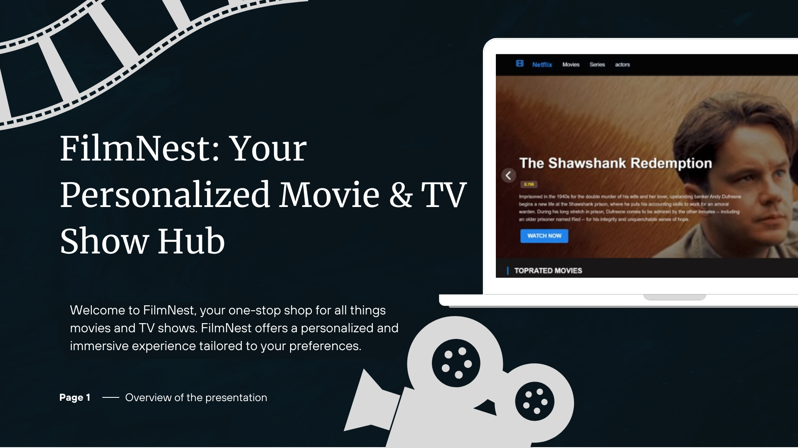

Slide 2
Problem: Fragmented Movie Discovery & Management
Lack of Centralized Data
Lack of Personalization
Finding movie information, ratings, and reviews across multiple sources can be inconvenient for users
Users struggle to find content tailored to their preferences, as the platform lacks personalization features
Page 2

Slide 3
Solution: Introducing FilmNest - All-in-One Platform
Centralized Hub
Personalized Experience
FilmNest aggregates movies and TV shows from various platforms, offering a comprehensive catalog.
FilmNest learns your preferences through your interactions, delivering tailored recommendations.
Page 3

Slide 4
Tech Stack: HTML, CSS, JS, TMDB API, Local Storage, Firebase
1
HTML, CSS, and JavaScript form the foundation of FilmNest's user interface and functionality.
2
The TMDB API provides access to a vast movie and TV show database, powering FilmNest's content.
3
Local storage allows users to save watchlists and preferences for offline access.
4
Firebase ensures data synchronization and real-time updates, enabling seamless user interactions.
Page 4

Slide 5

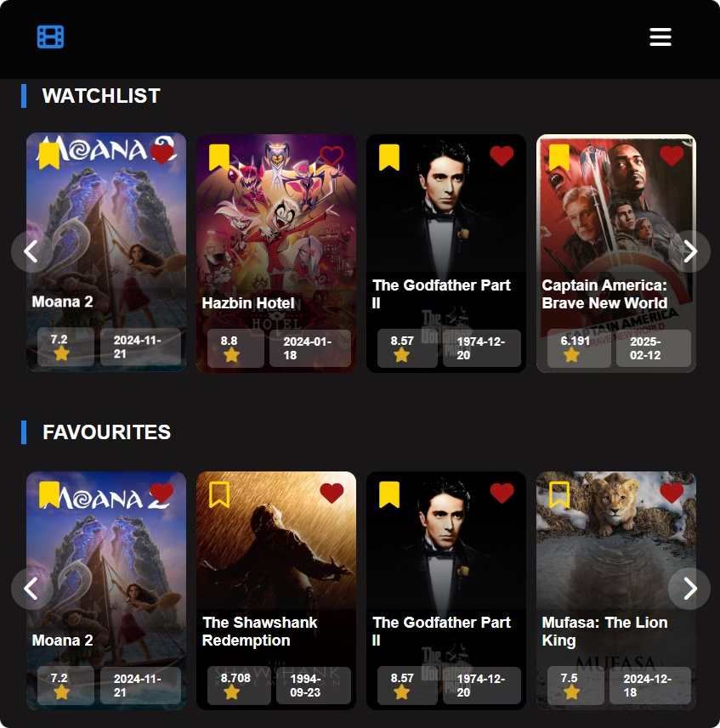


Key Features: Watchlists & Personalized Recommendations
Create and manage watchlists to keep track of your desired movies and TV shows.
Discover personalized recommendations based on your watchlist history and preferences.
Page 5

Slide 6
Dynamic Sorting & Filtering: Find Exactly What You Want
Genre
Release Date
Rating
Filter movies and TV shows by genre, such as action, comedy, drama, or science fiction.
Browse movies and TV shows by release year, from classic films to the latest releases.
Filter content based on its rating, ensuring you find movies and TV shows that align with your preferences.
Page 6

Slide 7
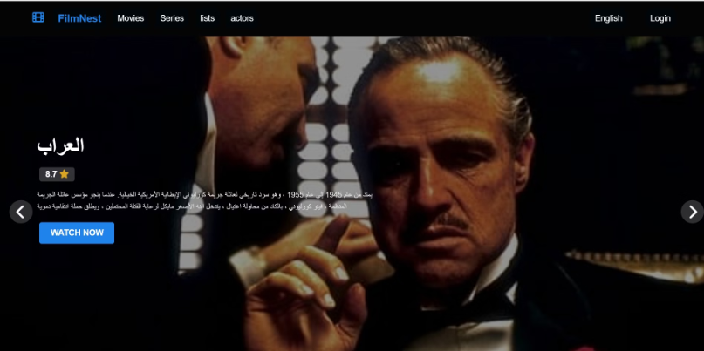

Multi-Language Support: English & Arabic Options
FilmNest offers user interface and content in both English and Arabic, ensuring accessibility for a wider audience.
Page 7

Slide 8
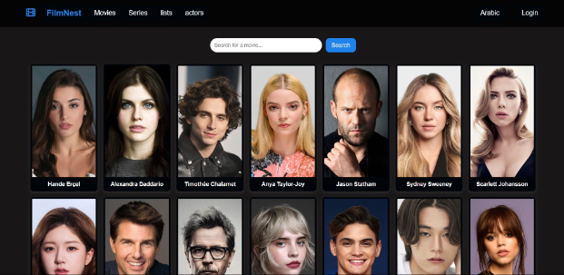
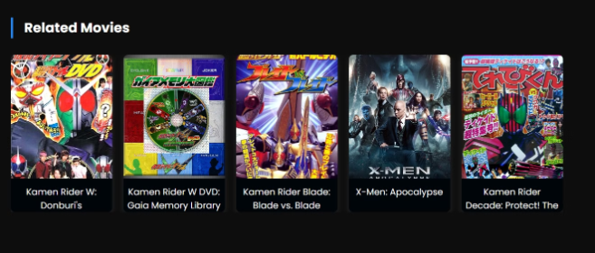
Actor Pages & Similar Movie Suggestions: Dive Deeper
Actor Pages
Similar Movie Suggestions
Explore dedicated actor pages with biographies, filmographies, and other relevant information.
Discover movies similar to your current favorites based on genre, actors, or directorial styles.
Page 8

Slide 9

Behind the Scenes: Development Challenges & Solutions
1
API Integration
Efficiently integrating the TMDB API for data retrieval and management.
2
User Interface Design
Creating a visually appealing and user-friendly interface for optimal navigation and engagement.
3
Data Storage & Retrieval
Optimizing local storage and Firebase for efficient data storage, retrieval, and synchronization.
Page 9

Slide 10



Conclusion
FilmNest: Your Personalized Hub
FilmNest provides movie and TV show discovery. It also enables you to find personalized content.
Key Features
Enjoy personalized recommendations. Also use multi-language support.
Future Development
We are commited to improving the app by providing more advanced features and content. Thanks for your attention.
Page 10

